Slide 1
Broadband Chesterfield Subscriber Survey
February 2022
165 Total Responses

Slide 2
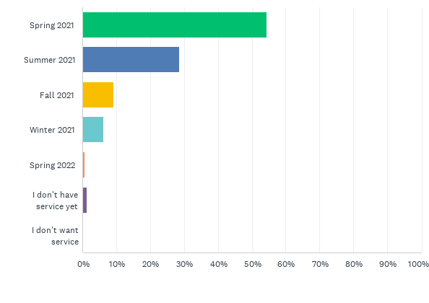
Q1: When did you get Broadband service?
Answered: 164 Skipped: 1

Slide 3
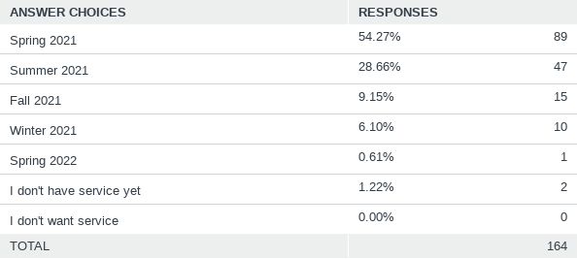
Q1: When did you get Broadband service?
Answered: 164 Skipped: 1

Slide 4
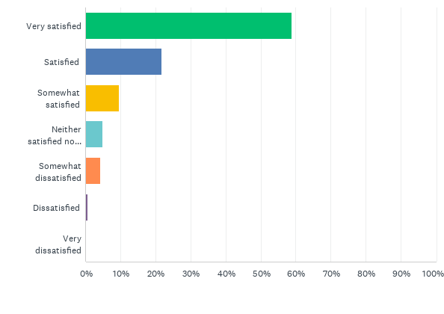
Q2: How would you rate your overall satisfaction with Chesterfield's new Broadband Internet Service?
Answered: 165 Skipped: 0

Slide 5
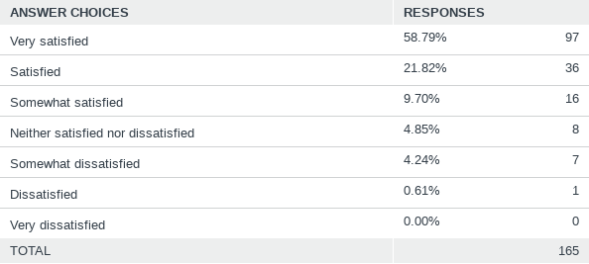
Q2: How would you rate your overall satisfaction with Chesterfield's new Broadband Internet Service?
Answered: 165 Skipped: 0

Slide 6
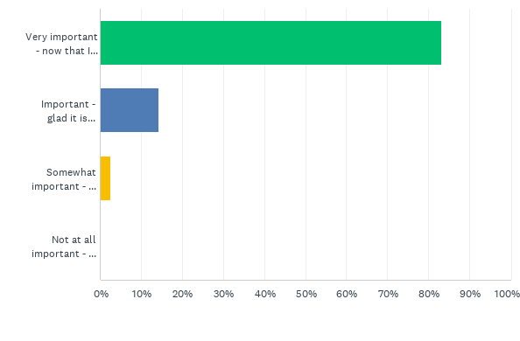
Q4: How important to you is having high speed broadband internet service?
Answered: 160 Skipped: 5

Slide 7
Q4: How important to you is having high speed broadband internet service?
Answered: 160 Skipped: 5

Slide 8
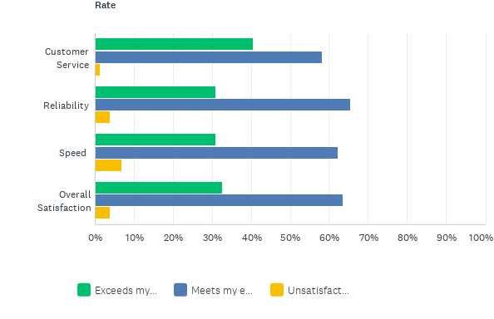
Q5: How would you rate the following aspects of Broadband Chesterfield?
Answered: 161 Skipped: 4

Slide 9
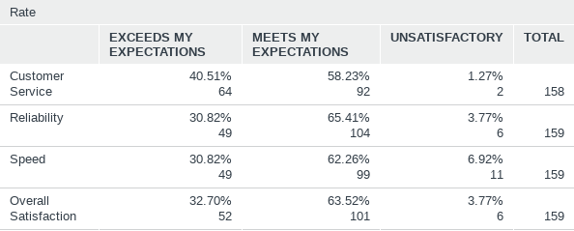
Q5: How would you rate the following aspects of Broadband Chesterfield?
Answered: 161 Skipped: 4

Slide 10
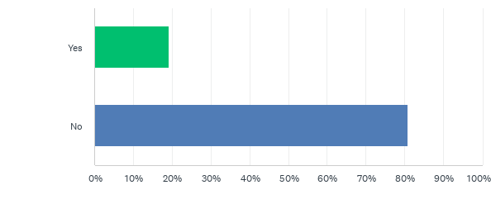
Q6: Have you experienced any interruptions in service that lasted longer than 1 hour?
Answered: 161 Skipped: 4

Slide 11
Q6: Have you experienced any interruptions in service that lasted longer than 1 hour?
Answered: 161 Skipped: 4

Slide 12
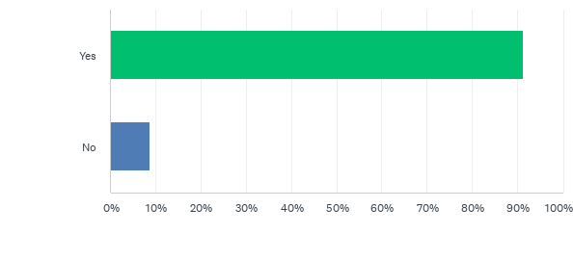
Q7: Did you have internet service prior to Broadband (DSL, Satellite, Cell Phone)?
Answered: 161 Skipped: 4

Slide 13
Q7: Did you have internet service prior to Broadband (DSL, Satellite, Cell Phone)?
Answered: 161 Skipped: 4

Slide 14
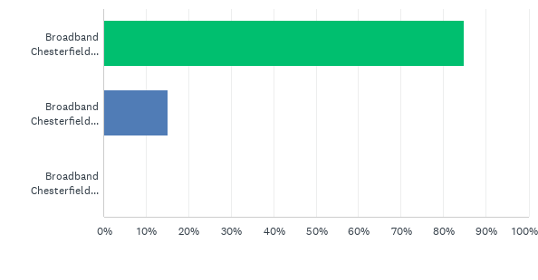
Q8: How would you rate Broadband Chesterfield service against your previous provider?
Answered: 146 Skipped: 19

Slide 15
Q8: How would you rate Broadband Chesterfield service against your previous provider?
Answered: 146 Skipped: 19

Slide 16
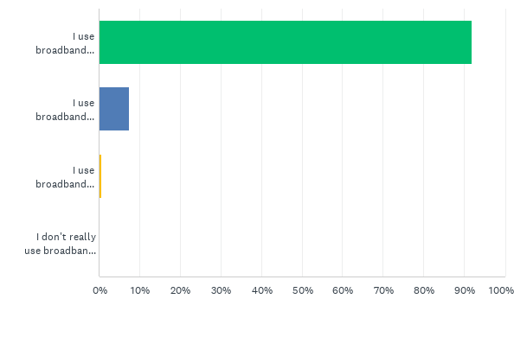
Q9: How would you describe your use of broadband internet?
Answered: 159 Skipped: 6

Slide 17
Q9: How would you describe your use of broadband internet?
Answered: 159 Skipped: 6

Slide 18
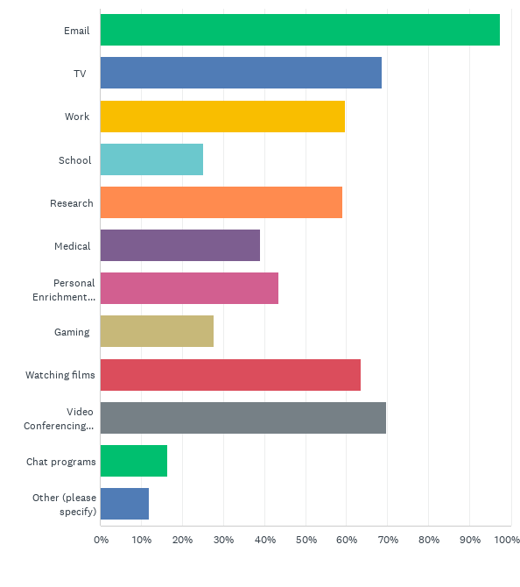
Q10: Which of the following do you use your broadband service for? Check as many as apply
Answered: 159 Skipped: 6

Slide 19
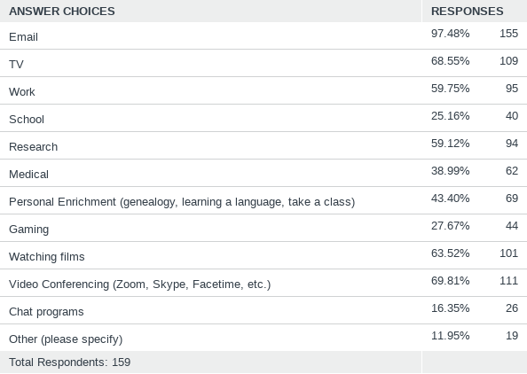
Q10: Which of the following do you use your broadband service for? Check as many as apply
Answered: 159 Skipped: 6

Slide 20
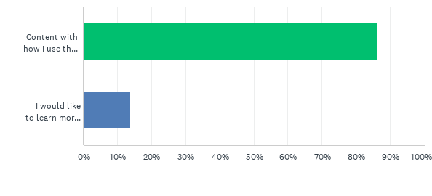
Q11: Are you content with your level of use of the internet or would you like to learn more?
Answered: 159 Skipped: 6

Slide 21
Q11: Are you content with your level of use of the internet or would you like to learn more?
Answered: 159 Skipped: 6

Slide 22
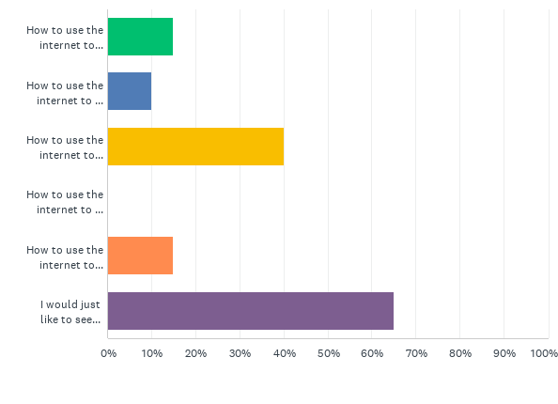
Q12: What type of training would you like to see offered?
Answered: 20 Skipped: 145

Slide 23
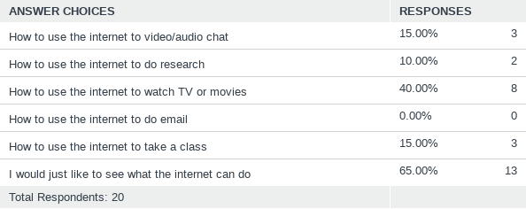
Q12: What type of training would you like to see offered?
Answered: 20 Skipped: 145

Slide 24
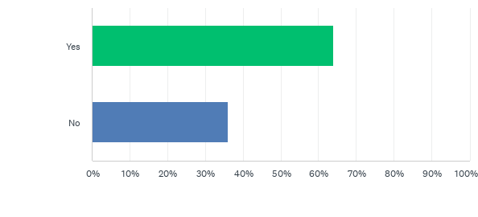
Q13: Have you contacted either Whip City Fiber Customer Service or Whip City Technical Support?
Answered: 158 Skipped: 7

Slide 25
Q13: Have you contacted either Whip City Fiber Customer Service or Whip City Technical Support?
Answered: 158 Skipped: 7

Slide 26
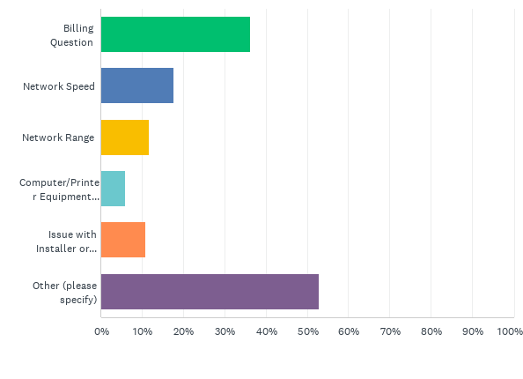
Q14: What were the issues you called about? Check as many as apply.
Answered: 102 Skipped: 63

Slide 27
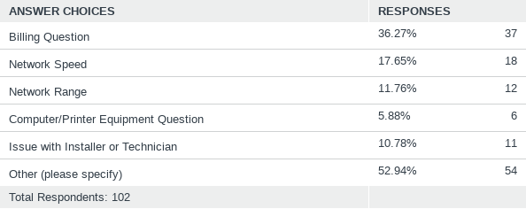
Q14: What were the issues you called about? Check as many as apply.
Answered: 102 Skipped: 63

Slide 28
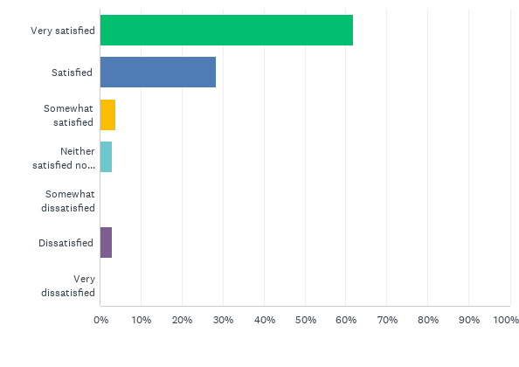
Q15: How satisfied are you with Whip City's customer/technical service?
Answered: 102 Skipped: 63

Slide 29
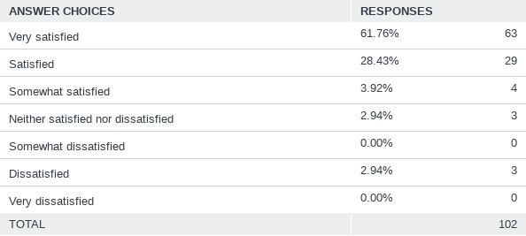
Q15: How satisfied are you with Whip City's customer/technical service?
Answered: 102 Skipped: 63

Slide 30
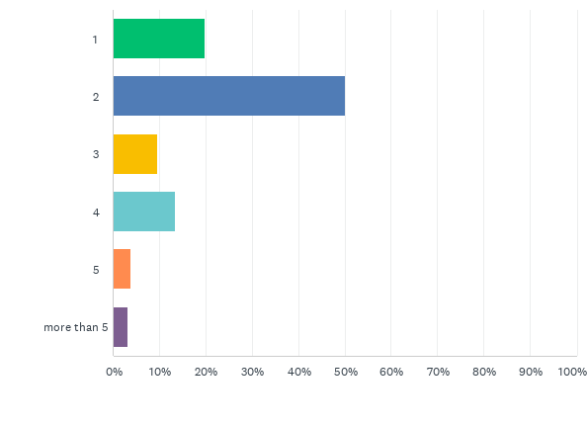
Q17: How many members of your household use the internet?
Answered: 156 Skipped: 9

Slide 31
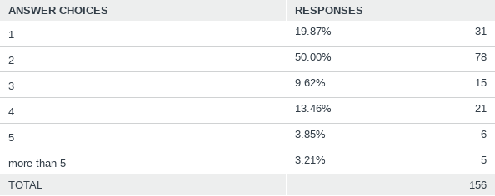
Q17: How many members of your household use the internet?
Answered: 156 Skipped: 9

Slide 32
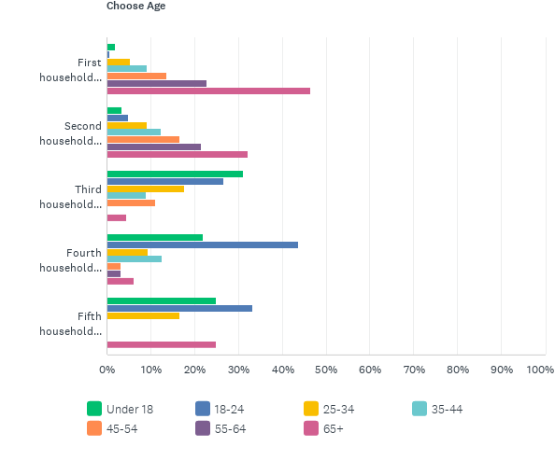
Q18: What is the age of each member of your household using the internet?
Answered: 153 Skipped: 12

Slide 33
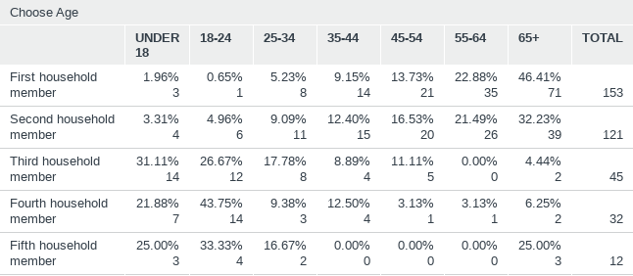
Q18: What is the age of each member of your household using the internet?
Answered: 153 Skipped: 12

Slide 34
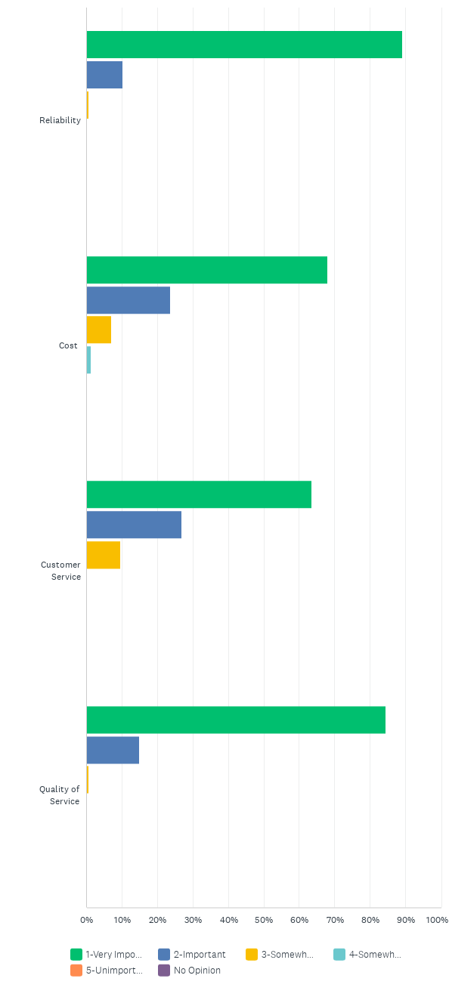
Q19: On a the following scale, please indicate how you feel about each of the following aspects of the Broadband network.
Answered: 156 Skipped: 9

Slide 35
Q19: On a the following scale, please indicate how you feel about each of the following aspects of the Broadband network.
Answered: 156 Skipped: 9

